Slide 1
Smart Parking Spot Locater
MOHAMMED THOUFEEK A (202IT170)
JAYAVISHNUSIVAM R (202IT148)
SURYA A (202IT241)
SUKIRTHA SREE V M (202IT237)

Slide 2
Abstract
Finding an available parking place in a densely crowded urban area can be quite challenging. There may be a significant traffic bottleneck due to the lack of parking space. People waste time stuck in traffic and in parking lots. For all metropolitan communities to deal with traffic and parking problems, an automatic parking system is necessary. It's a new field, too. We introduced the smart parking slot locator in this article to assist drivers in locating available parking spaces and to decrease parking and traffic congestion. We first used calibration to divide the parking space into distinct chunks. Then, after analyzing each block, inform the driver of its availability. Then, using our smart technology, analyze each block to inform the motorist about availability, whether the block is reserved or not.

Slide 3
Problem Statement Addressed
Difficulty finding parking spots in public places
Takes time to find a parking spot
The main problem in searching for a parking space is losing time and wastage of fuel. Due to the availability of guidance, people were unknown about the vacant place. So, they are rotating around the parking place for a long time in search.

Slide 4
Existing Solution to the Problem Addressed
Existing solution
- Hire people to direct drivers to vacant spots
- Using security camera and parking attendant

Slide 5
Proposed Solution to the Problem Addressed
Our solution
- A low cost device to locate the vacant spots in a parking lot
- Several cameras
- Personal computer
- Microcontrollers
- Image processing software

Slide 6
Project Work Plan
Camera captures images of the parking lot
Microcontroller segments images into individual parking spaces by cropping out critical areas of each parking space
Microcontroller processes images of the individual parking spaces.
Sends vacant spot ID numbers wirelessly to PC.
PC uses information to update a GUI display of the parking lot.

Slide 7
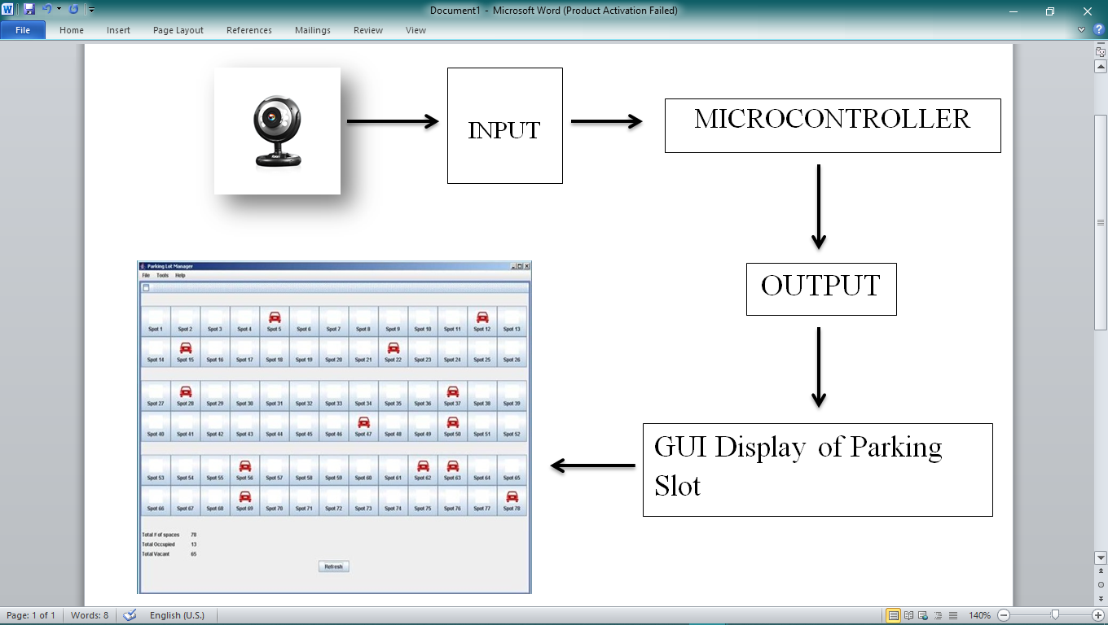
Block Diagram

Slide 8
Effective utilization of the Modern Tool
Data Transmission
- Vacant ID numbers vs. Captured images
- Burden on PC instead of microcontroller
Data Communication
- Low cost wireless connection
- Infrared or Radio transmitters
Interfacing of the devices
- Embedded microcontroller into a camera
- Develop an adaptable microcontroller
End User Display
- A brand new GUI based program

Slide 9
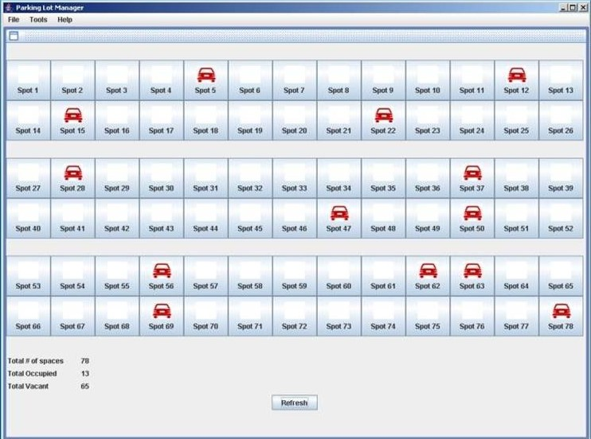
Prototype & Sample Output

Slide 10
Analysis of Results & Discussions
Advantages:
Reduces the wastage of time and fuel.
It helps to identify the parking space in a short duration.
It helps to reduce the unwanted traffic.
Reduce the hiring of man power.
Disadvantage:
Investment require
Maintenance
Generator required during breakdown of current

Slide 11
Cost Benefit Analysis (List of Components / Service Used)
S.No | Component Name | Specification (IC number or Range or Value) | Unit Cost | Total Cost
1 | Matlab (License) |  | ₹ 66,000 | ₹ 66,000
2 | Personal Computer |  | ₹ 75,000 | ₹ 75,000
3 | Camera |  | ₹ 20,000 | ₹ 20,000
4 | Microcontroller |  | ₹1,500 | ₹ 1,500
5 | Transmitter |  | ₹3,500 | ₹3,500
6 | GUI Display |  | ₹50,000 | ₹50,000

